Slide 1

Ubuntu linux and teams

Slide 2
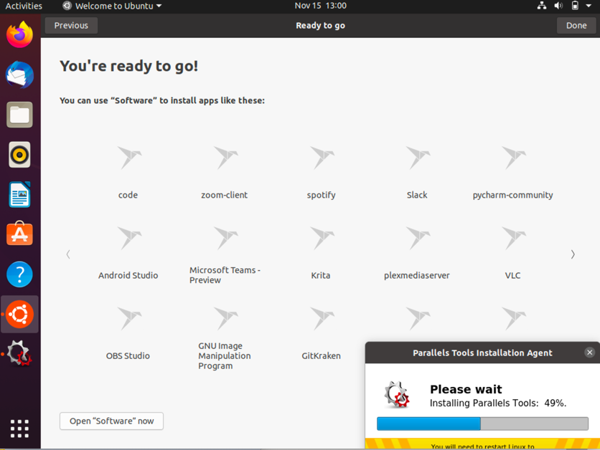
Ubuntu linux – install software like ms teams preview

Slide 3
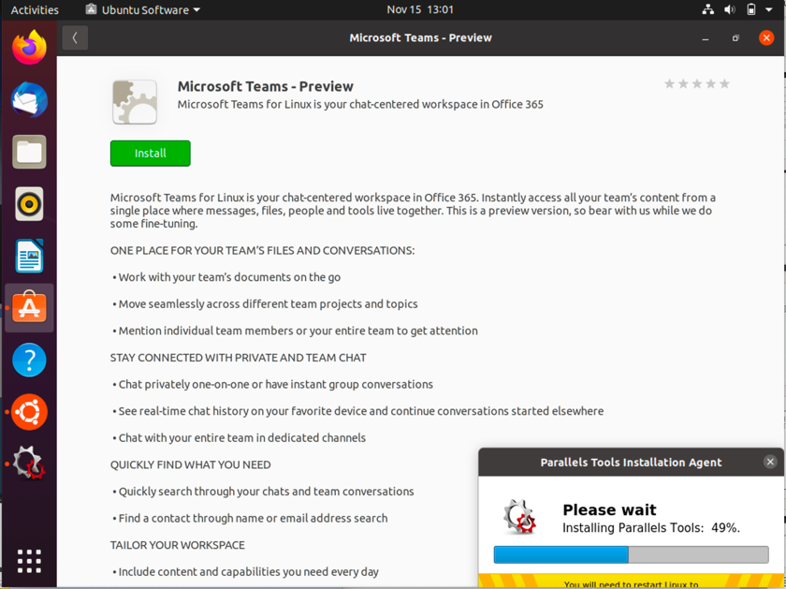
Install the preview app! (also available at http://teams.microsoft.com/downloads)

Slide 4
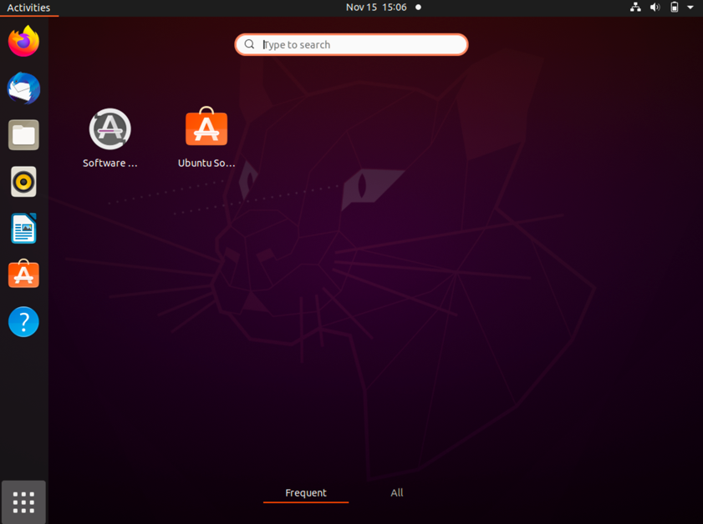
Once install completes, search for teams

Slide 5
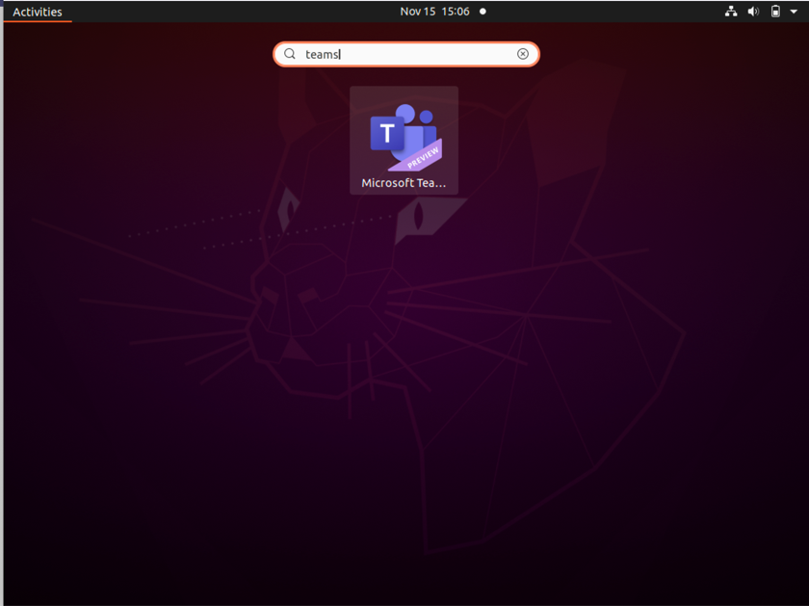
After installation – search and launch microsoft teams preview

Slide 6
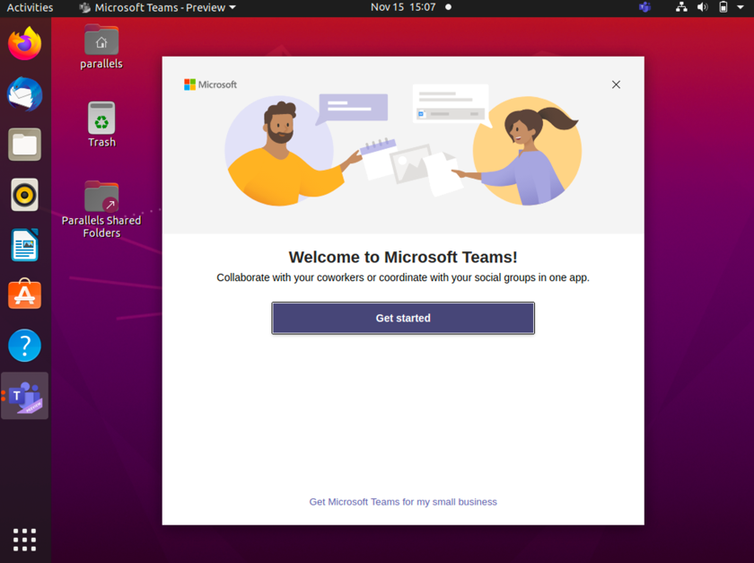
Application Preview launches

Slide 7
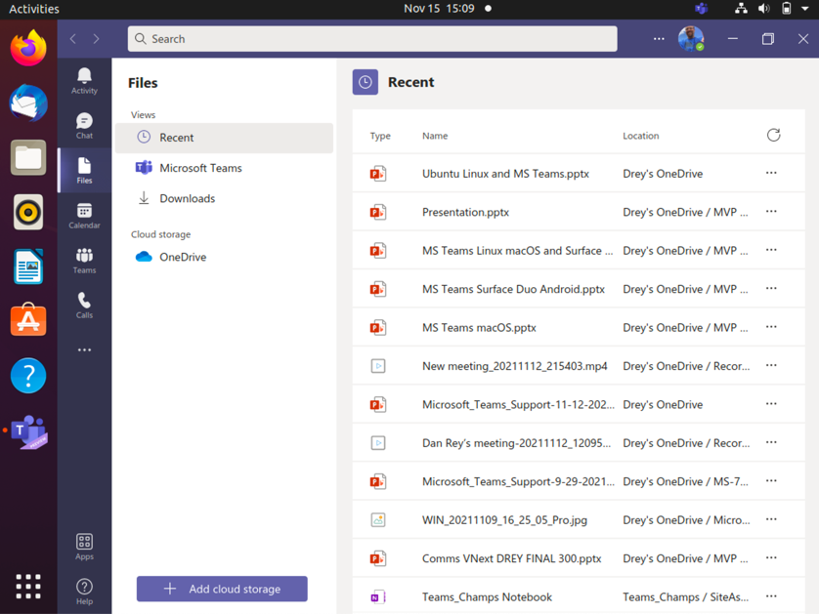
files

Slide 8
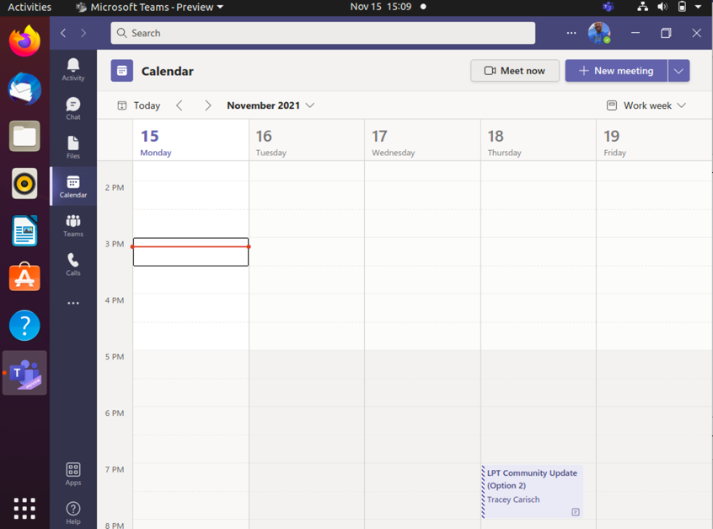
Calendar

Slide 9
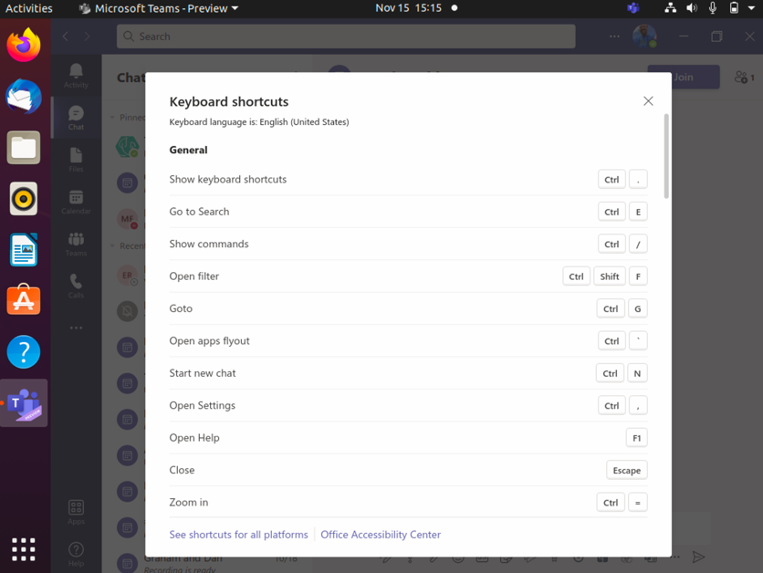
Keyboard shortcuts on linux app

Slide 10
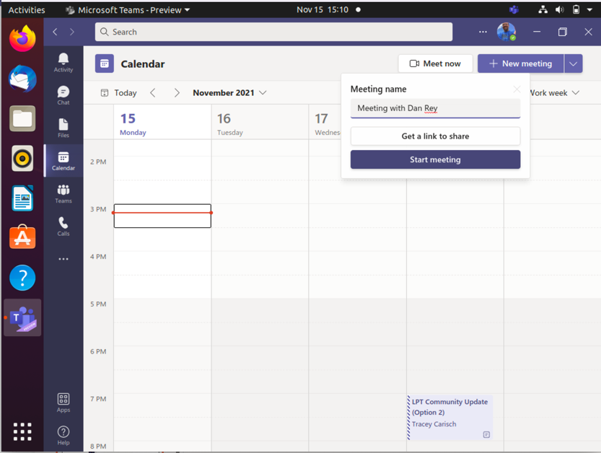
Meet now button

Slide 11
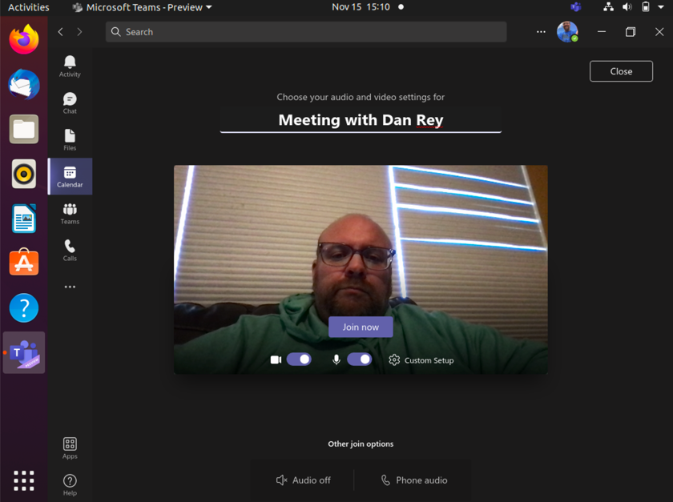
Meeting window (no backgrounds or noise supression yet)

Slide 12
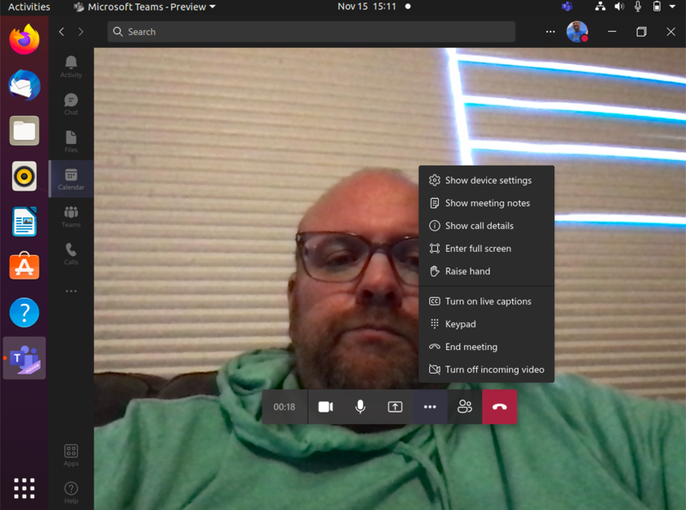
No background blur or custom backgrounds yet

Slide 13
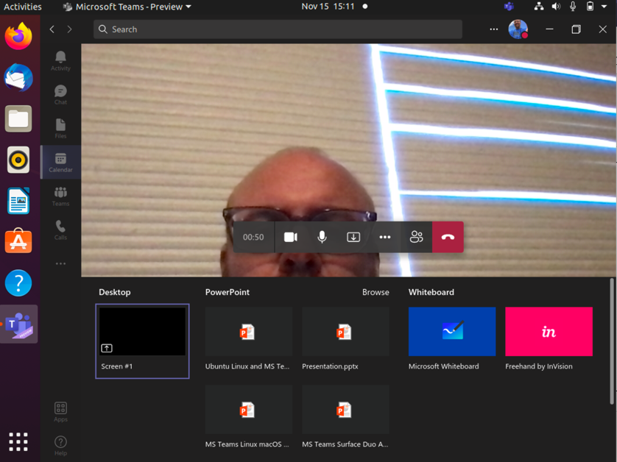
Full screen sharing only (no app window sharing yet)

Slide 14
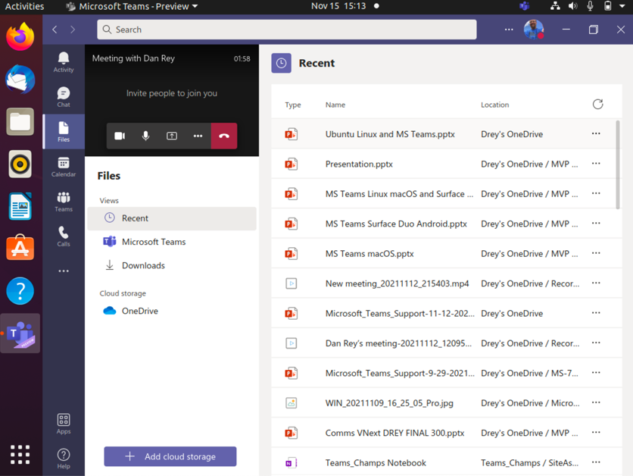
Single window experience (like the browser)

Slide 15
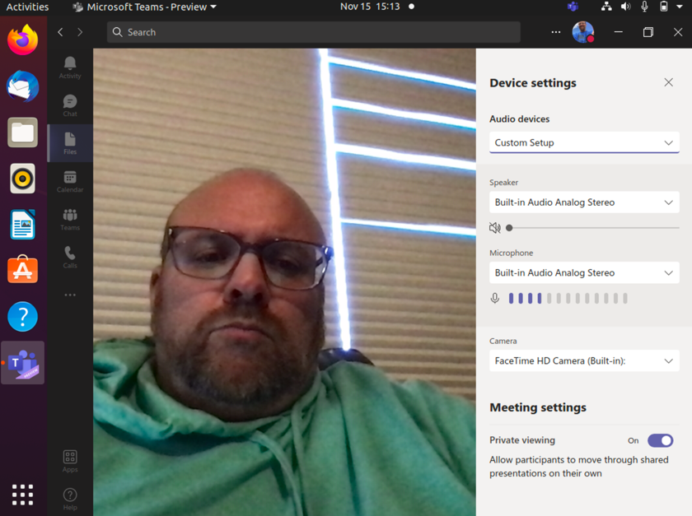
Devices – no noise suppresssion yet either

